Slide 1
PL# 4-5 Power:
Hard vs Soft
Power?
Power of government?
Power of ideas?
Power of persuasion and coercion

Slide 2

What is POWER?

Slide 3
Power relationships involve coercion and sanctions to overcome resistance.
Power is the amount of political control a person or group has in a country (C1)
Power is the ability to control people and events (B1)

Slide 4
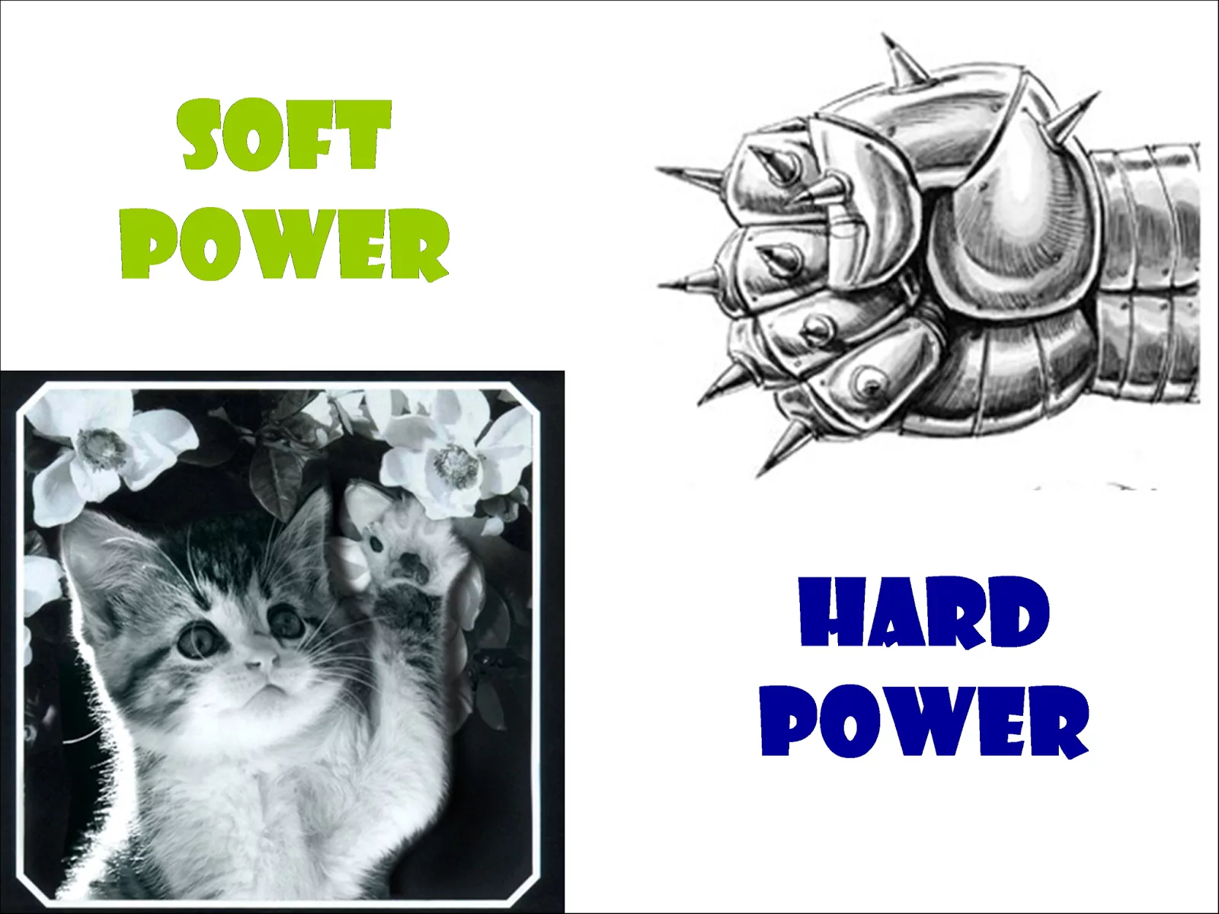

Slide 5
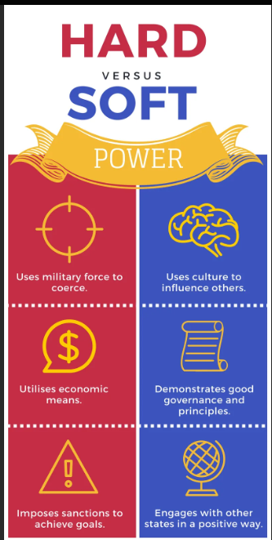

Slide 6
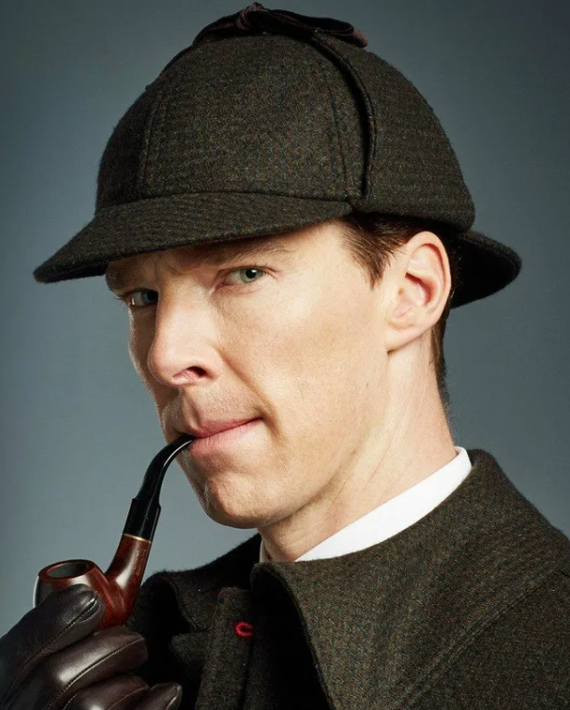
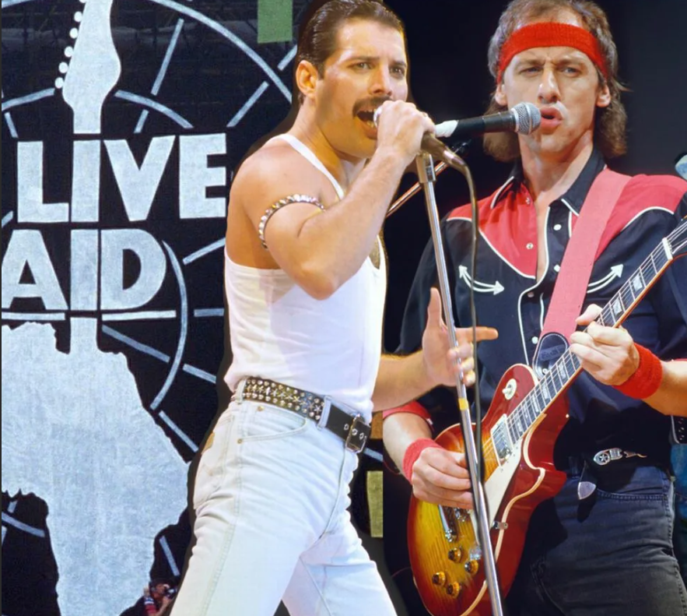
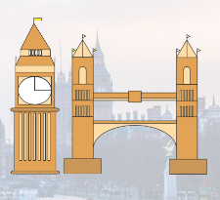

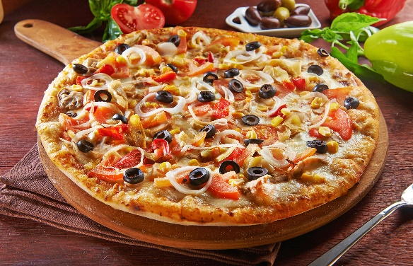
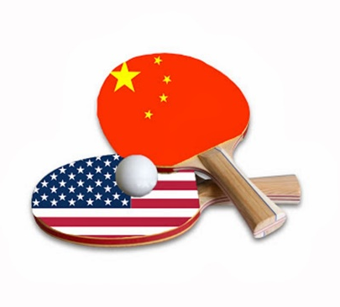

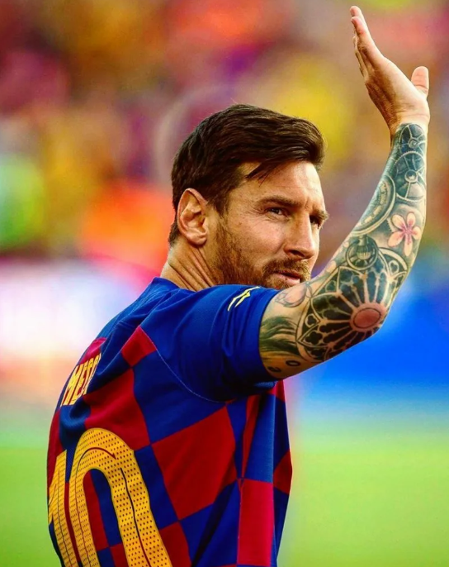

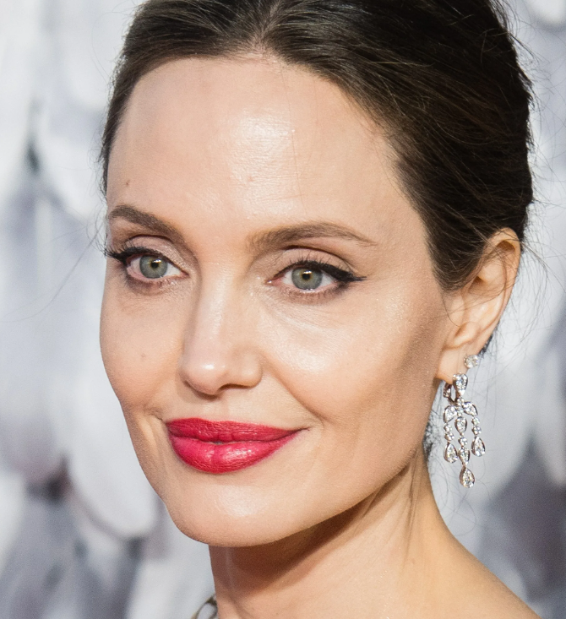

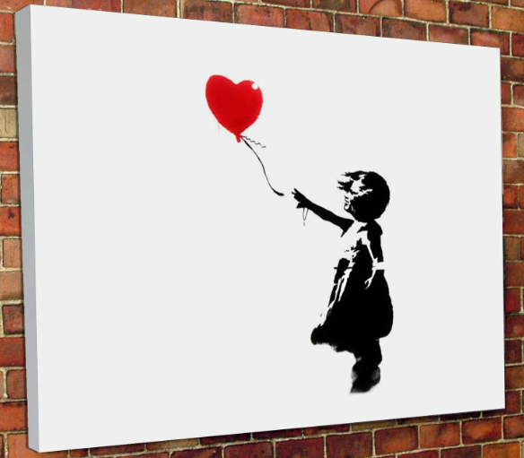
SIW#1 National values as a soft power tools
Literature/book diplomacy
Music diplomacy
Cultural diplomacy
City diplomacy and twin-towning
Gastro-diplomacy
Movie diplomacy
Sports diplomacy
Pop star diplomacy
Linguistic diplomacy
Event diplomacy
Art diplomacy

Slide 7
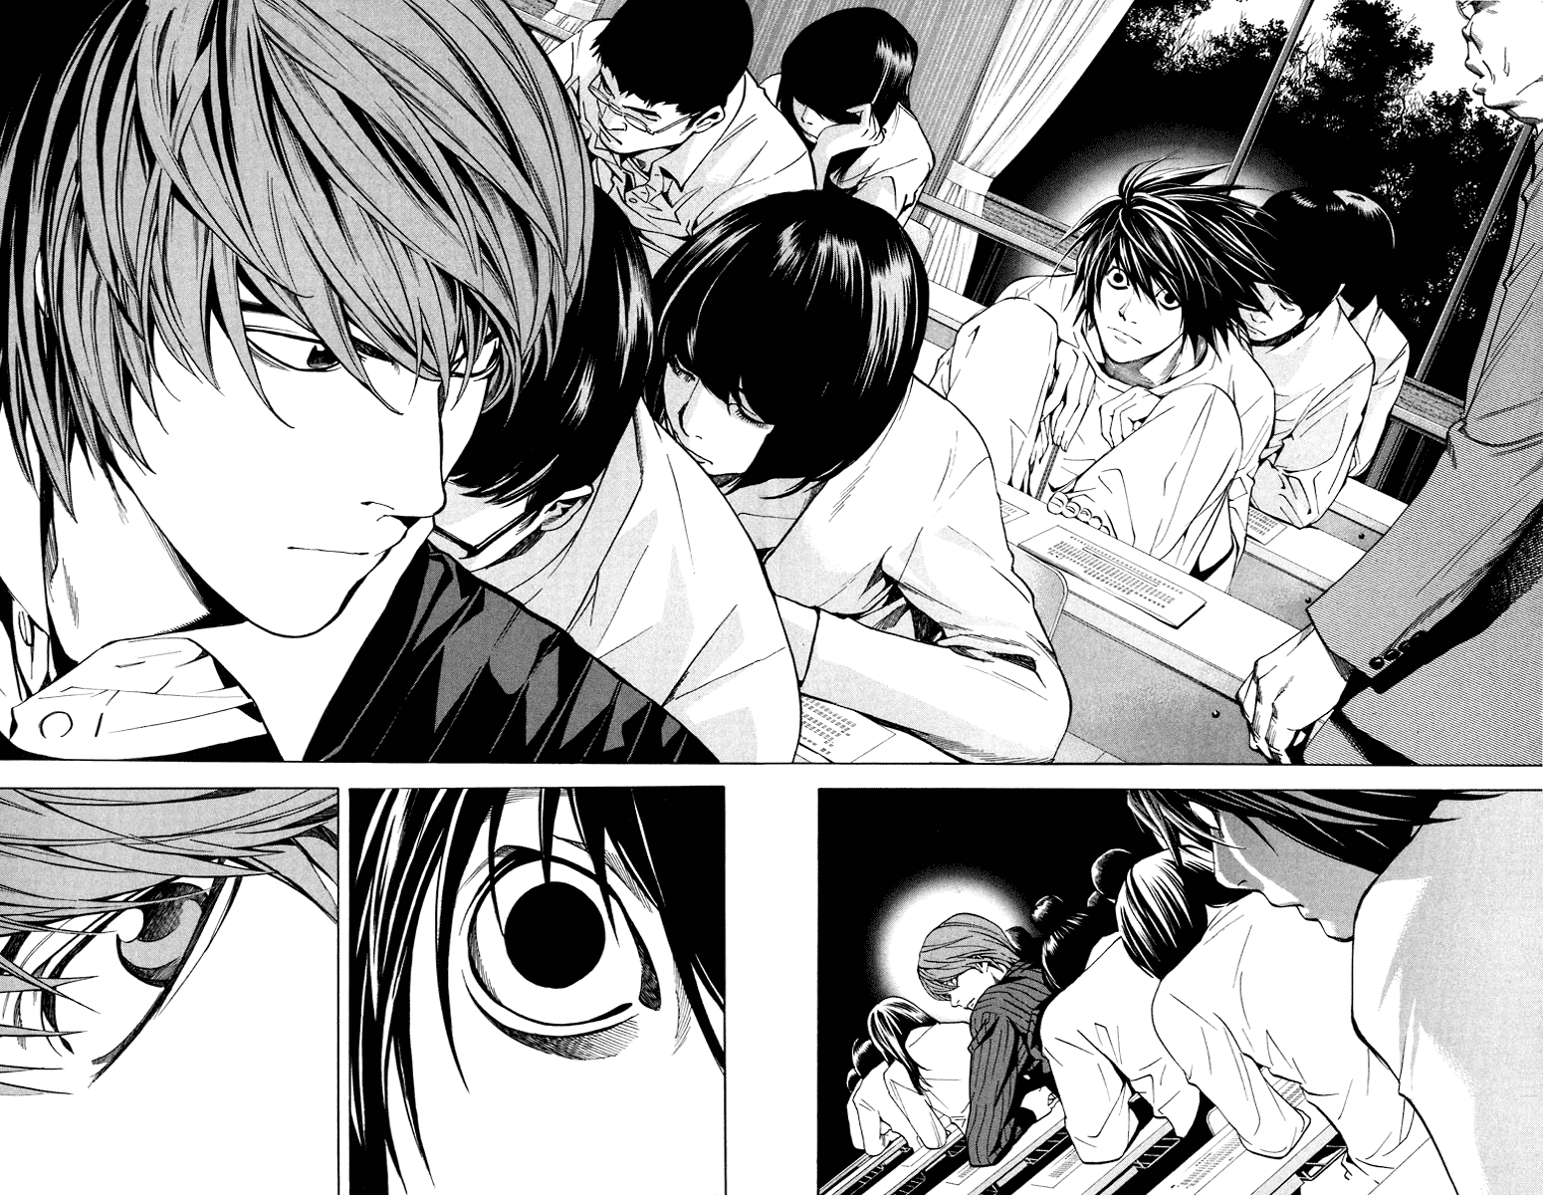
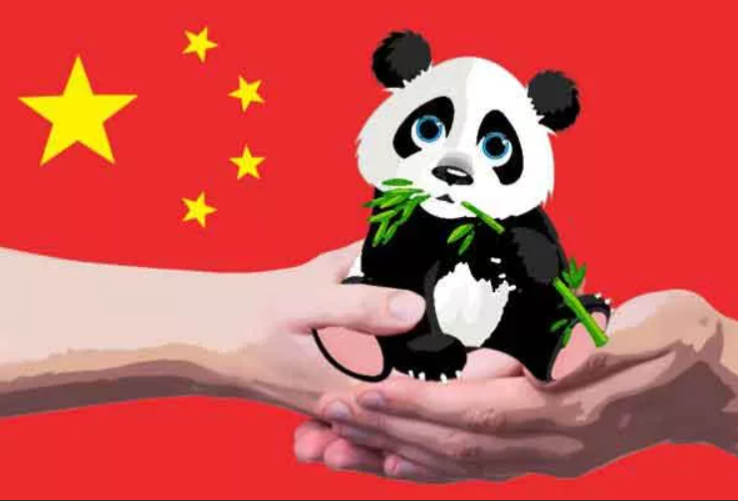
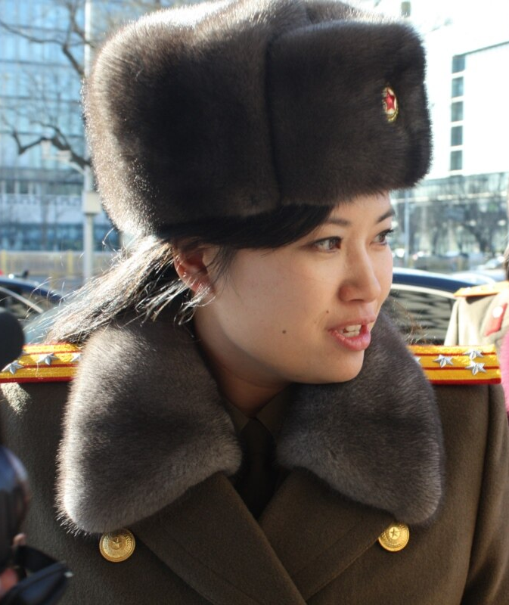
SIW#1 National values as a soft power tools
Form: social media project
1) Choose a national object / thing/ figure / phenomenon as the foundation to develop a new kind of cultural diplomacy of your country

Slide 8
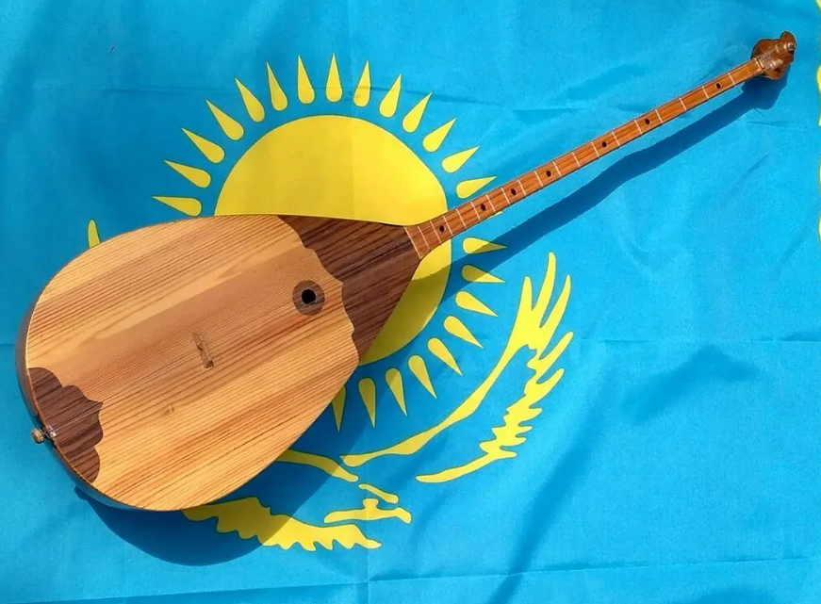
SIW#1 National values as a soft power tools
2) Create a catchy name for your new kind of cultural diplomacy of your country
3) Define your new kind of cultural diplomacy of your country
Dombra diplomacy

Slide 9

SIW#1 National values as a soft power tools
4) Explain the meaning / history of the national object / thing/ figure/ phenomenon in short
5) Describe the mechanism of this kind of cultural diplomacy: how it is going to work (give examples/ strategies of introducing it to foreign publics and promoting it abroad)
6) Present the results of your project in the form of social media video post / reels with your voiceover and caption (2–3 min)
@nationalvalues_project
Deadline: October 14th 2023
Number of points: 17
You may use programs like Canva, Splice, InShort, and others to create the video post or reels.

Slide 10
SIW#1 National values as a soft power tools
Criteria for assessment:
Language proficiency: diplomatic vocabulary, proper pronunciation (voiceover), correct spelling (caption or subtitles), B2 grammar structure (passives, conditionals, relative clauses, perfect modals, etc.)
Creativity, imagination, visual representation: how well you present the national idea from diplomatic perspective
Meeting the deadlines

